Slide 1
2025 Tentative Budget
Presented to:
Board of supervisors
October 18, 2024

Slide 2
The Economy
GDP: The county's GDP increased by 4.7% from 2020 to 2021.
Median property value: The median property value in Schoharie County was $209K in 2023, which is 11.7% higher than the previous year. This has increased to $237K, a 9.2% rise
Homeownership rate: The homeownership rate in Schoharie County is 77.4%, which is similar to the national average.
Median household income: The median household income in Schoharie County was $71,479 in 2022.

Slide 3
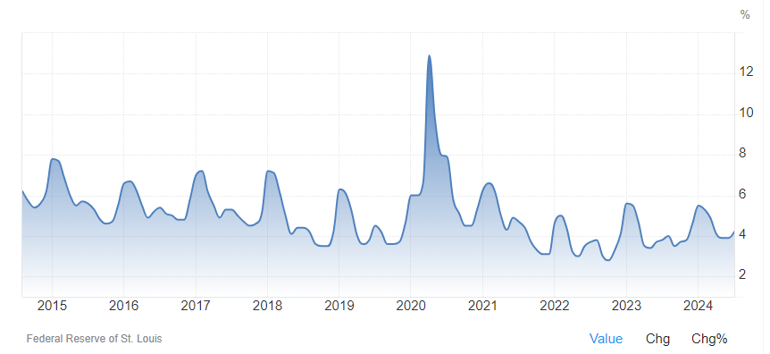
Inflation
In May 2024, inflation was at 3.5% year over year, which was the lowest level in three years.
Inflation reached 8% in 2022, a 40-year high.
Wage changes, rent costs, and the importation of goods are some of the most expensive parts of inflation.
We have also seen an accelerated increase in basic household goods.
Food inflation is also high, and costs have not returned to the pre-pandemic levels

Slide 4
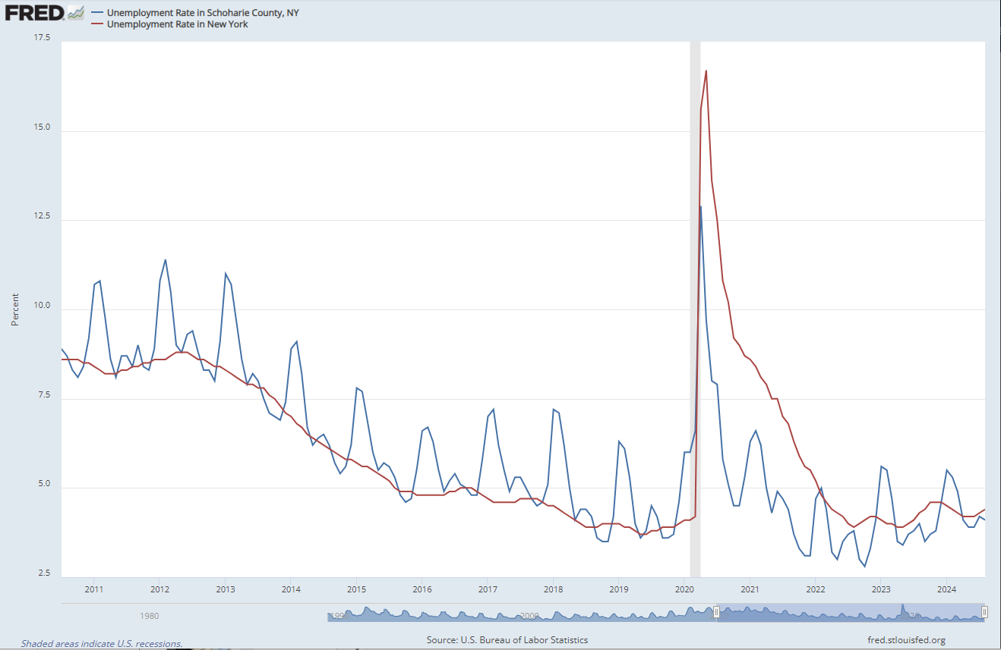
Unemployment
The August unemployment rate in Schoharie County of 4.1% is lower than the NYS average of 4.4%
Unemployment Rate in Schoharie County, NY was 4.2% in July of 2024
Unemployment Rate in Schoharie County, NY reached a record high of 12.9% in April of 2020 and a record low of 2.8% in October of 2022.

Slide 5
Overview of 2024 County Gov’t Operations
Munis Enterprise Resource Program (ERP) aimed to streamline county government financial management went Live in January 2024.
Economic Development Coordinator position was filled to bring focus to economic development as a key driver for growth in the county.
The County Successfully submitted a grant application to NYS Municipal Infrastructure Program (MIP) to bring broadband to every address in Schoharie County.
Classification Study is ongoing to rationale pay scale and enhance salary parity across the various departments and agencies.
Working with Bonadio Group to develop a comprehensive compliance program for the County. This is a first of such a plan for the County
Revamp of County Website is ongoing to enhance citizen engagement and participation in policymaking

Slide 6
Overview of 2024 County Gov’t Operations
Munis
Financial management module went Live in January 2024
Payroll, August 2024 with first check from the new system on September 13th.
Payment Processing & Advance Scheduling is scheduled, and we anticipate going live before end of first quarter 2025.
We still rely on old check printing system to print some checks.
As of July, we have utilized the inhouse system to print over 1,000 checks.
The inhouse system will be switched off by end of this year and working with Munis to create upload to ensure the County fully transitions to the ERP.
2025 Budget was largely processed in Munis.
Payroll projections were manually imputed in the new system
Bank reconciliation is still done manually.
Human Capital will be fully rolled out by end of Q1 2025. It is expected that all employee evaluations, employee safety and all other operational needs will be fully automated in Munis.
Employee self service is also expected to be fully rolled out at the same time.

Slide 7
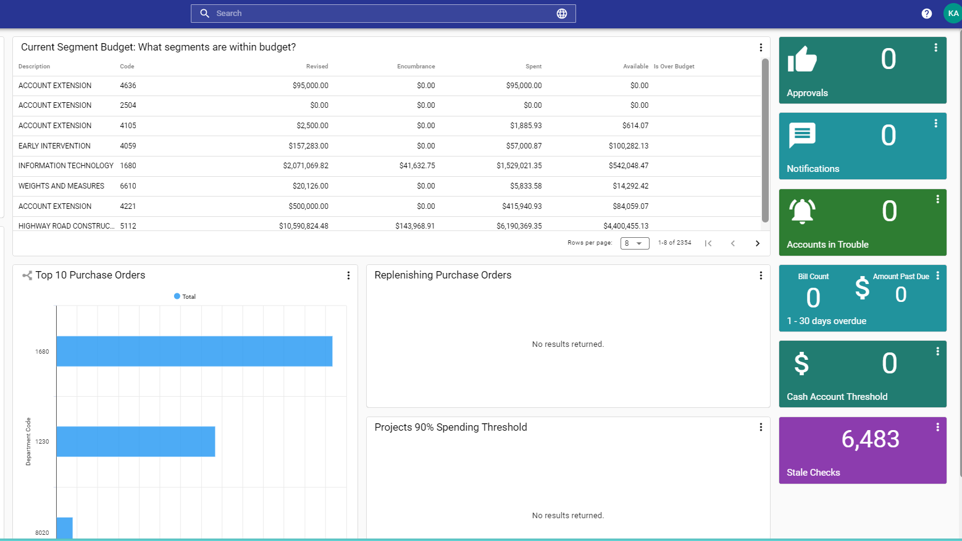

Slide 8
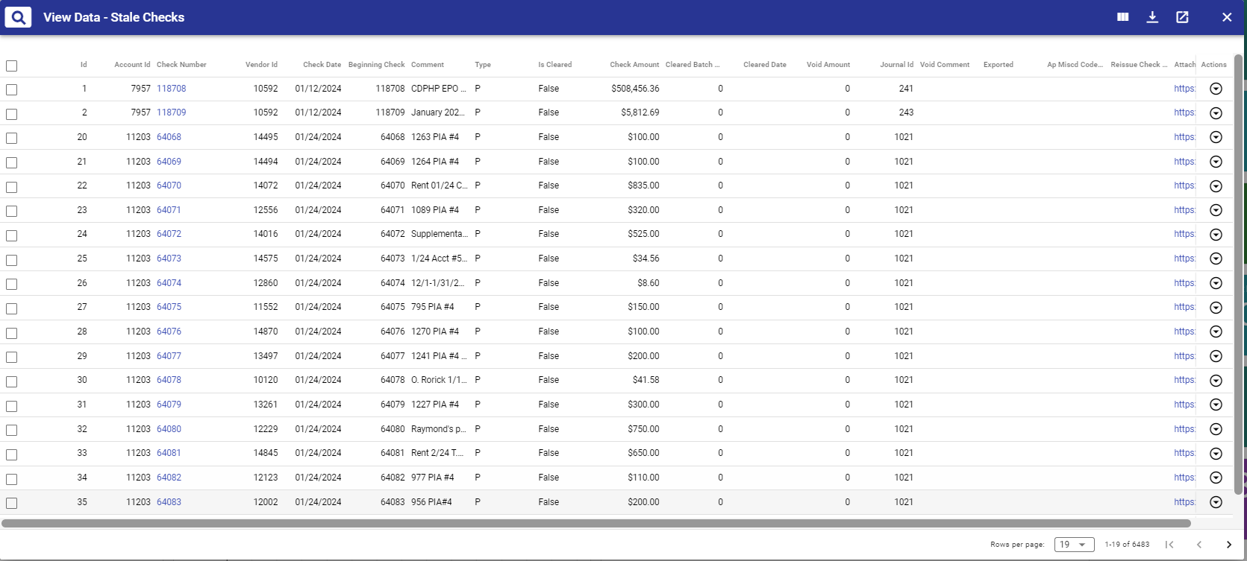

Slide 9
Overview of 2024 County Gov’t Operations
DiscoverEGOV - NeoGov
Delayed implementation of Civil Service Software
Expected to go live by December 2024
The Tool will enhance and make efficient the operation of the personal office and their interaction with all other municipalities, schools and other local government agencies that we support.
Schoharie county will have the capacity for job seekers to apply for open positions and reduce the duplication of data entry that has existed in the county for many years
All other civil service activities will be desegregated to improve efficiency.

Slide 10
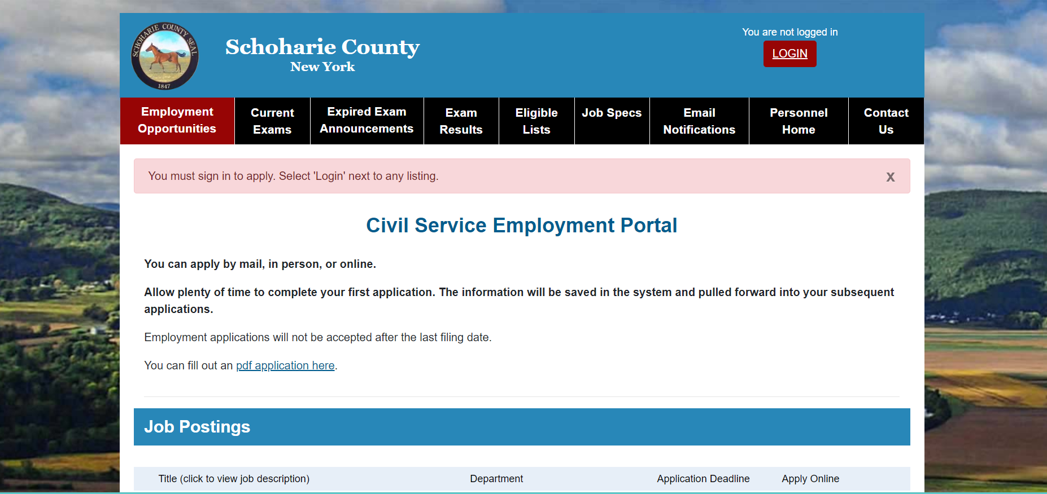

Slide 11
2024 Cost Drivers

Slide 12
Personnel & Benefit
 | ind 8
 | Yr
 | 2020 | 41.0% | 41.00%
 | 2021 | 40.4% | 40.44%
 | 2022 | 39.5%
 | 2023 | #DIV/0!
 | 2024 | #DIV/0!
 | ind 8
 | Yr
 | 2020 | 41.0% | 41.00%
 | 2021 | 40.4% | 40.44%
 | 2022 | 39.5%
 | 2023 | #DIV/0!
 | 2024 | #DIV/0!
Total cost of Personnel expenses in 2023 $23.6 M
Cost of Benefits total $14.5 M
Since 2019, payroll has grown on average 12.39% annually.
Benefit payment since 2019 averages 68% of payroll cost
Payroll cost as of 10/11/24 - $18.9 M. We are projected to end the year at $24.1M.

Slide 13
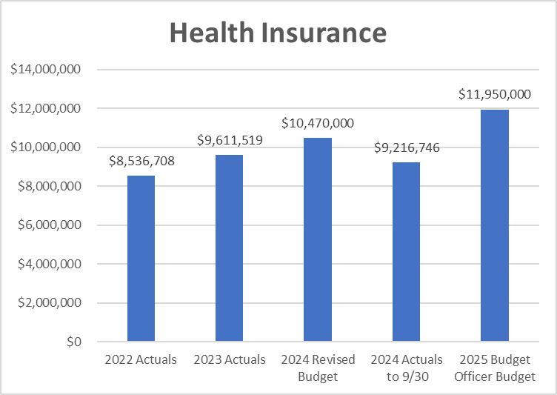
Health Insurance
Health Insurance – Aug. 2024
Subscribers
CDPHP 279 Employees, 18 Retirees
NYSHIP 27 Employees, 235 Retirees and 11 Surviving Spouses

Slide 14
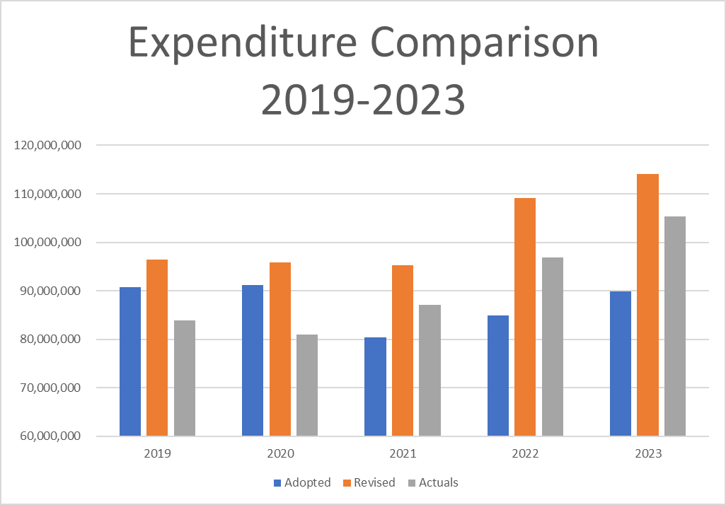
2024 Fund Expenditure Comparison
Expenditure in 2023 was $105 M Including debt servicing .
2024, total actual exp (10/11/24) $90.75M
Including $7.59M in BAN Principal payment
At the same period in 2023, actual exp was $70.6 M. a 17.72% increase year-on-year (excluding the BAN).
Same level of expenditure was reflected in 2023 as 2022.

Slide 15
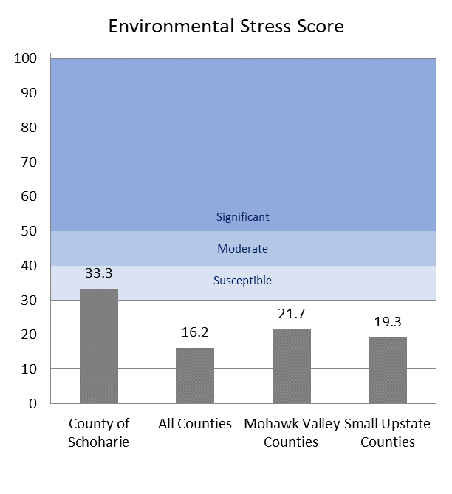
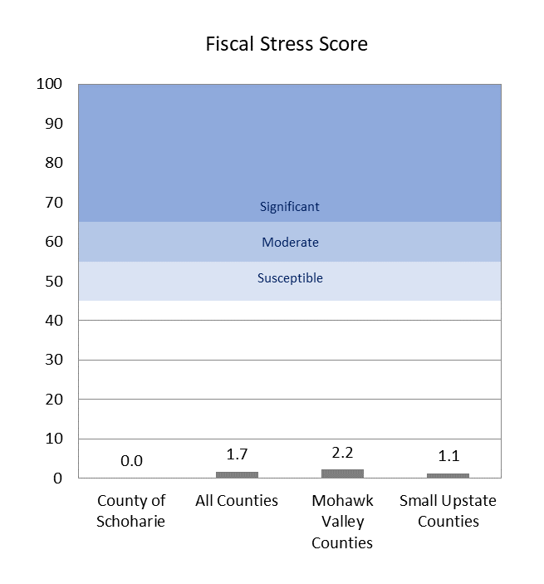
Restoring Fiscal Stability Depends on A Full Economic Recovery
 |  |  |  | name | amt
 |  |  |  | County of Schoharie | 33.3
 |  |  |  | All Counties | 16.2
 |  |  |  | Mohawk Valley Counties | 21.7
 |  |  |  | Small Upstate Counties | 19.3
 |  |  |  | none
 |  |  |  | No Designation | 30.0
 |  |  |  | Susceptible | 10.0
 |  |  |  | Moderate | 10.0
 |  |  |  | Significant | 50.0
 | Peer Group Size*: |  | 54 | 6 | 18
 |  |  |  | name | amt
 |  |  |  | County of Schoharie | 33.3
 |  |  |  | All Counties | 16.2
 |  |  |  | Mohawk Valley Counties | 21.7
 |  |  |  | Small Upstate Counties | 19.3
 |  |  |  | none
 |  |  |  | No Designation | 30.0
 |  |  |  | Susceptible | 10.0
 |  |  |  | Moderate | 10.0
 |  |  |  | Significant | 50.0
 | Peer Group Size*: |  | 54 | 6 | 18
Schoharie County has a solid fiscal score, but the future of the county’s fiscal position is susceptible to environmental factors
Population Loss & Reliance on State/Federal Aid destabilizes Schoharie County Finances relative to other NYS counties
Revenues are vulnerable to decisions made by state and federal entities
In comparison with the state, Mohawk Valley and small upstate counties, we have highest unemployment rate, and we depend on state and federal aid more than others.
These factors have not changed for many years, focus and investment in economic & community development will enhance the county positions in years to come.
Source: NYS Comptroller Fiscal Stress Report

Slide 16
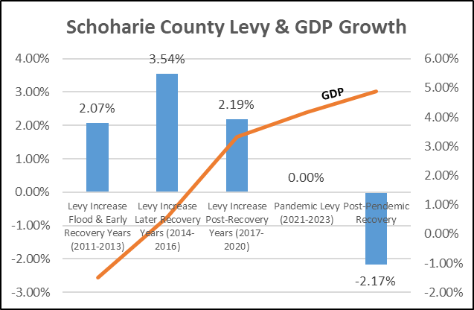
The Board Drives Economic Growth By Keeping the Levy Low
2014-2016: Average Levy Increased 3.54% while Average GDP Grew .58%
2017-2020: Average Levy Increased 2.19% while GDP Grew 3.32%
The data shows that low levies return strong economic growth.
Real GDP rate for 2018-2019 grew by 5.3%
2020 saw a decline of 11%. That reversed to a growth rate of 4.7% in 2022.
Schoharie County Economy will witness great resurgence with investment in Broadband.

Slide 17
2025 Budget Summary

Slide 18
2025 Budget Goals
Provide a balanced budget.
Maintain core county services and programs in the most cost-effective manner possible.
Comply with the New York State property tax Cap and continue our effort to rationalize property tax to make us competitive in the region.
Provide funding for prioritized projects and programs while avoiding fiscal stress and protecting our fiscal stability.
Use realistic estimates for both expenditure and revenue.
Support capital investment goals through enhanced Capital Improvement Planning (CIP)

Slide 19
2025 Tentative Budget: Highlights & Summary
The 2025 Tentative Budget outlines financial plans for the County. It proposes appropriations, tax levies, and revenue projections. This overview highlights key aspects and changes from previous years.

Slide 20
Budget Overview
1
Total Appropriation
The 2025 Tentative Budget proposes $99,387,309 in appropriations. This represents a 0.34% reduction from 2024.
2
Comparison to Revised 2024 Budget
The 2025 proposal is $19.2 million, (16.4%) less than the revised 2024 budget of $118,688,698.
3
Current Services Approach
This budget maintains 2024 service levels. It accounts for salary increases, inflation, and necessary equipment replacements.

Slide 21
Property Tax Levy
2025 Proposed Levy
Increase from 2024
Tax Cap Compliance
The Tentative Budget proposes a Property Tax Levy of $22,168,130 for 2025.
This represents a $574,032 (2.6%) increase over the 2024 adopted Tax Levy.
The proposed increase remains under the 4.30% tax cap, demonstrating fiscal responsibility.

Slide 22
2025 “Current Services” Budget
The Tentative Budget is a “current services” budget representing anticipated costs at the 2024 level of service in 2025. There are some increases over 2024, such as inflation, salary, and the replacement of equipment at the end of its useful life.
Not included is about $877K of program enhancements submitted by Departments to expand, improve or provide efficient services to residents. These proposals will be examined in depth by the Finance Committee.

Slide 23
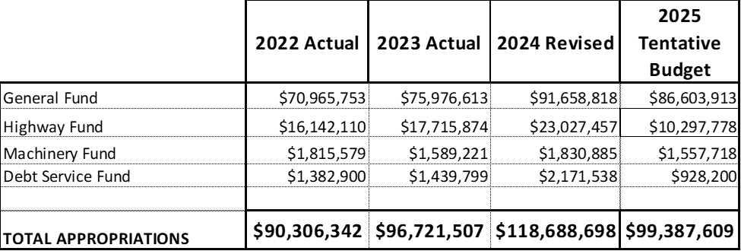
Appropriation Summary

Slide 24
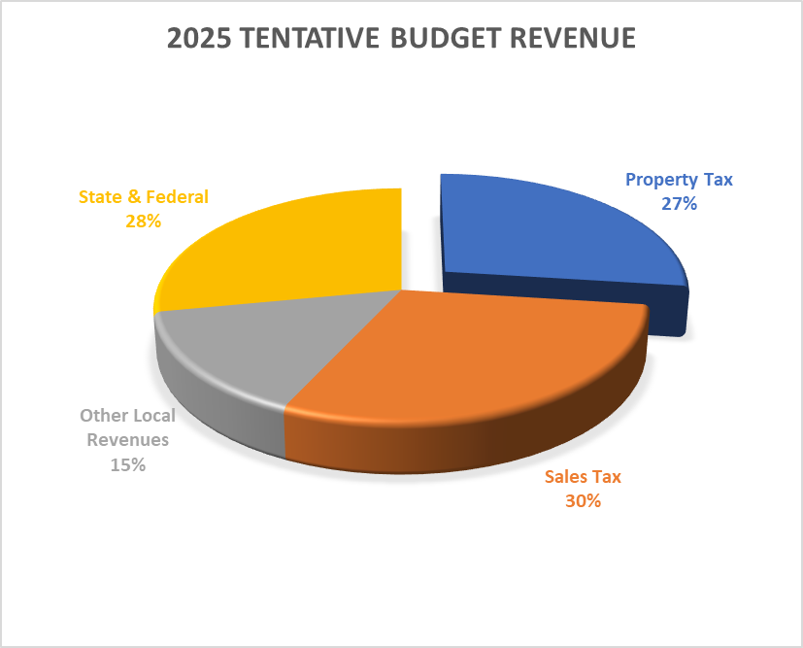
Revenue summary

Slide 25
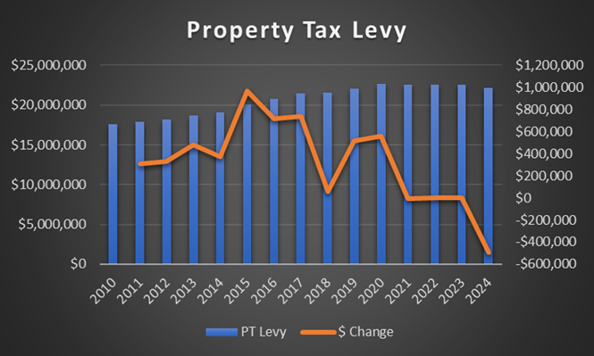
Tentative Budget Proposes Levy Increase of 2.6%
The proposed Levy increase of 2.6% or $574,024
The Tentative Budget Levy utilizes $5 M Fund Balance to achieve the 3.6% increase.
In 2023, the adopted budget ultimately appropriated $3.15 million to eliminate any levy increase.
$6.8M of fund balance was also utilized in the 2024 Budget.
The board has authorized the use of Fund balance for the past 4 years to keep property taxes flat.

Slide 26
2025 “Current Services” Budget
2023 Actuals
1
Sales tax revenue in 2023 showed strong performance, setting a baseline for future projections.
Sales Tax Revenue
Projections
2024 Projections
2
The 2024 sales tax revenue is expected to exceed 2023 totals by 3.5%.
2025 Forecast
3
The Tentative Budget projects Sales Tax Revenues of $24,485,885 for 2025, an increase from 2024.

Slide 27
Sales Tax Revenue Projections
 | 2022 | 2023 | 2024 | 22-24 | 23-24
Jan | $1,456,814.74 | $1,625,969.92 | $1,672,218.78 | 15% | 2.84%
Feb | $1,203,687.26 | $1,415,712.02 | $1,472,587.66 | 22% | 4.02%
Mar | $2,201,368.67 | $2,097,317.08 | $2,277,042.60 | 3% | 8.57%
Apr | $1,697,995.34 | $1,629,102.86 | $1,853,185.33 | 9% | 13.75%
May | $1,652,948.82 | $1,582,755.83 | $1,896,458.93 | 15% | 19.82%
Jun | $2,036,751.16 | $2,881,528.77 | $2,383,430.27 | 17% | -17.29%
Jul | $1,588,907.85 | $1,803,057.83 | $2,129,181.74 | 34% | 18.09%
Aug | $1,534,535.06 | $1,754,399.38 | $2,124,673.41 | 38% | 21.11%
Sep | $3,266,926.12 | $3,446,769.59 | $2,421,536.69 | -26% | -29.74%
Oct | $1,598,090.38 | $1,696,372.23 | $0.00
Nov | $1,562,416.03 | $1,647,262.44 | $0.00
Dec | $2,356,608.66 | $3,001,570.26 | $0.00
Total | $22,157,050.09 | $24,581,818.21 | $18,230,315.41 | 82% | 74%

Slide 28
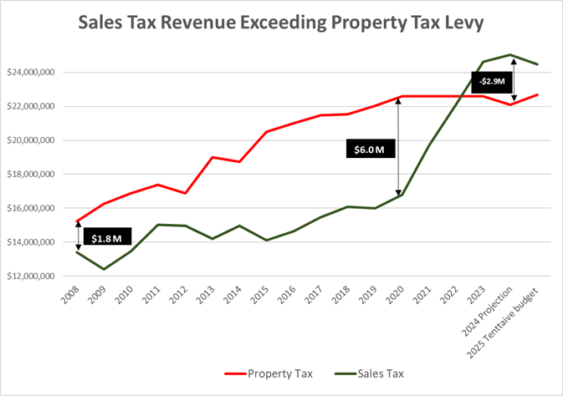
Tentative Budget Projects Significant Sales Tax Increase
2025 Sales Tax Revenue is projected at $24.4 M. $2.3 M more than was budgeted for 2024.
Through September, however, the county has received $18.2 M or 82% of the total 2024 budgeted Sales Tax revenue of $22.1 M.
Total Sales Tax Revenue for 2024 is currently estimated at $25.4 M.
Schoharie county sales tax revenue exceeded property taxes in 2023 and same is projected for 2024.

Slide 29
General Fund Balance
Appropriation for 2025
The Tentative Budget proposes appropriating $5 million from the General Fund Balance.
Current Balance
As of December 31, 2023, the Unassigned General Fund Balance stood at $42.3 million.
2024 Bond Payoff
Excess of $11 million of General Fund Balance has been earmarked to payoff maturing bonds.

Slide 30
Fund Balance & Legacy Debt Overview
General Fund
Unassigned Fund Balance as of 1/1/2024 $49.13 M
Amount set aside to reduce the 2024 Tax Levy $ 6.8 M
Anticipated increase prior to 12/31/24 $ 4.20 M
Anticipated decrease prior to 12/31/24 $ 11.50 M
Estimated Available Unassigned
$ 34.23 M
Road Fund
Unassigned Fund Balance as of 1/1/2024 $3.66 M
Anticipated Increase prior to 12/31/2022 $ 525K
Anticipated Decrease prior to 12/31/2023 $0 M
Estimated Available unassigned $ 4.18 M
Indebtedness
Streambank Stabilization Project II $ 7.31 M
Total Indebtedness
$ 7.31 M

Slide 31
31
Program Enhancements
Proposed Enhancements
Review Process
Resident Impact
Department Heads submitted $877,000 in program enhancement proposals. These aim to expand or improve county services.
The Finance Committee will examine these proposals in depth. They will make recommendations to the Board.
These enhancements could potentially
improve efficiency and quality of
services for county residents.

Slide 32
ARPA
$6.02 Million Total
$ 4.4 Million Infrastructure Investment
$ 1.62 Million Revenue Loss and other related investment
Projects are at various stages and the county is committed to seeing to the completion of all projects within the allowable timeframe.
Due to the obligation need by end of 2024, the committee continues to review projects and make changes where necessary to ensure all funds are retained.

Slide 33
Key Decisions by the Board towards 2025
Set aside $2.5 Million towards repair and maintenance of county office building Annex and Court House
What is the appropriate tax increase and how much additional fund balance do we use to support the budget?
Continuous Investment in Law Enforcement to Provide 24/7 Police coverage county-wide
Earmark Fund to support long term Economic Development Opportunities
E.g., Allocate part of unbudgeted excess sales tax revenue to economic development fund.

Slide 34
Current Status
Discussions with Road Patrol and Corrections unions are ongoing. No budgetary allocation made in the 2025 tentative budget
Board's Commitment
The board aims to expand law enforcement coverage in the county to 24/7.
Rationalization Corrections PayScale to make us competitive.
Ongoing Negotiations
Future Implications
The outcome of these negotiations will impact future budgets and service levels.

Slide 35
Achieving Long-Term Sustainable Financial Future
Strategy that focuses on economic growth in the long term.
Reform the county government to make it more efficient and affordable for our residents by utilizing technology to improve Communication & Outcomes.
Benchmark & measure county government services for increased accountability to taxpayers and residents.
Improve on the Capital Improvement Plan to meet our economic development strategy & Utilize Capital Planning for Better Efficiency.
Efficiency and Savings through Planned attrition, not layoffs.

Slide 36
Next Steps
Action
Responsible Party
Timeline
Review Tentative Budget
Finance Committee
October 22-30, 2024
Public Hearings
County Board
November 12, 2024
Final Budget Approval
County Board
November 15, 2004

Slide 37
Questions

